Slide 1

NATIONAL INSTITUTE OF ELECTRONICS
AND
INFORMATION TECHNOLOGY
A PROJECT REPORT
BASED ON
“COLLEGE WEBSITE TEMPLATE”
(Submitted in partial fulfilment for the award of the degree)
Of
IT- O Level
Under the guidance of
Mr. Minajul Haque
(IT faculty, Nielit Tezpur)
Submitted By
Pranab Das
Jaydeep Sarkar
Hriday Narzari

Slide 2
TABLE OF CONTENTS
Introduction
Background Study
Requirement Specifications
Objectives
Screenshots
Conclusion

Slide 3
INTRODUCTION
In this modern world, every institution is connected with the internet. This makes easier for the students or people interested in that particular institution to learn and interact with the institute with ease, from anywhere and without leaving the comfort of their own home.
The website is designed using HTML, CSS, Java Script and Node JS.
This website includes tabs such as Home, Admissions, Gallery.
We have developed Login and Signup pages using back end programming.
This website gives information about, on going activities, such as on going admissions, news, etc, in form of marquee scrolling.
This website provides information about history of the institute and other information such as about the founder, The principal, staff teachers and others.

Slide 4
BACKGROUND STUDY
To develop the project we have gone through HTML, CSS, Java Script and Back-End knowledge, which we have acquired via, regular classes, interaction with teachers, surfing net, and other sources.
To develop the project we have done a thorough background study on :
Websites and its types.
Webpages
Html
CSS
JavaScript
Node JS
To develop the project we used software's such as :
Visual Studio Code
Notepad/Notepad++
Anaconda

Slide 5
REQUIREMENT SPECIFICATIONS
HARDWARE REQUIREMENTS:
Processor: Dual core
Ram: 4 Gb
SSD: 512 Gb
SOFTWARE REQUIREMENTS :
System type: 32/64 bit operating system
Browser: chrome, edge, etc.
Other software: Notepad/Notepad++, VS Code

Slide 6
OBJECTIVES
To develop websites related to LOKD College .
Data collection
Layout designing
Sample page designing
Simple Back-End
To provide necessary and some more information regarding the history, administration, academics, and some miscellaneous info.
To provide quick access by easy navigation on contents.
To provide a medium to connect and contact the college for the students as well as visitors.
To make aware about the present academic status of the institute.

Slide 7
SCREENSHOTS

Slide 8
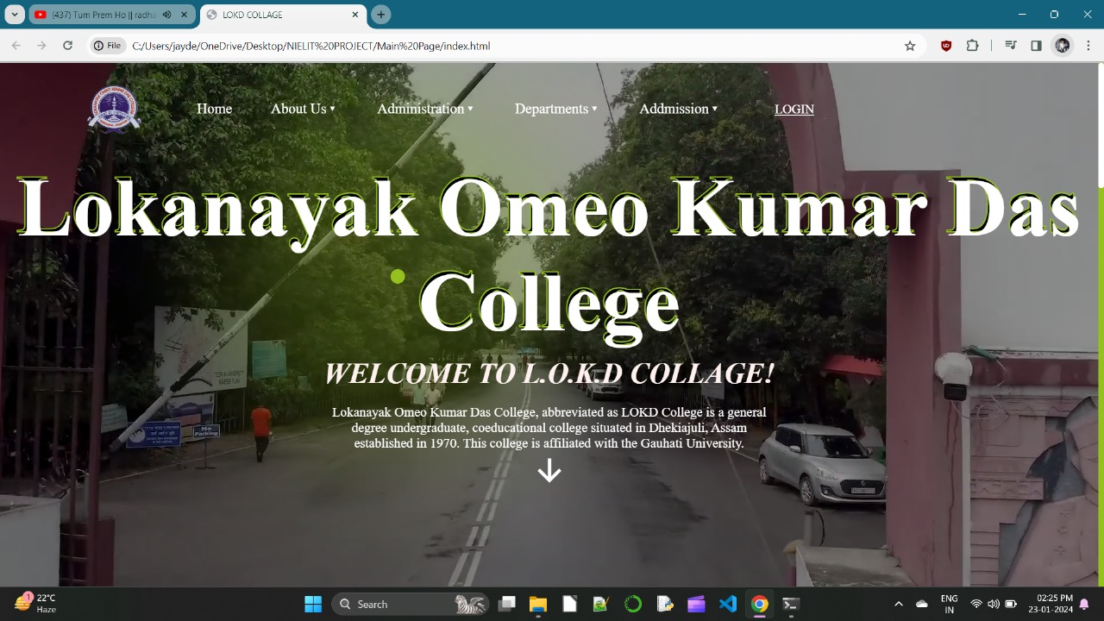
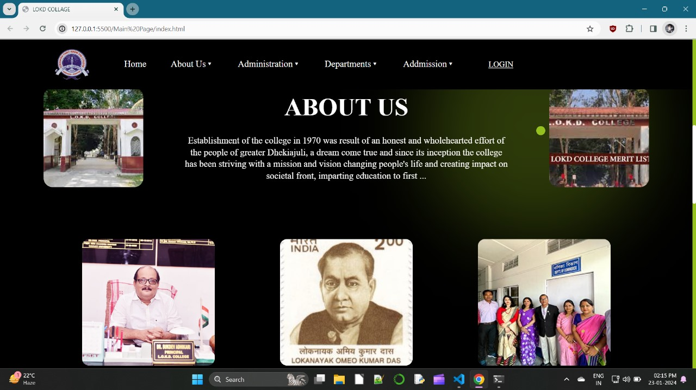
We can see the front page of the website. In this page one can see the name of the website in bold cool fonts and design with tabs such as home , about us, login and others. This part of the website welcomes the visitor to scroll and surf through our site.
We have shown the about us page in which one can see and know about the college and they can learn about the peoples behind the foundation and formation of the college which includes, the principal, the teachers and others.

Slide 9
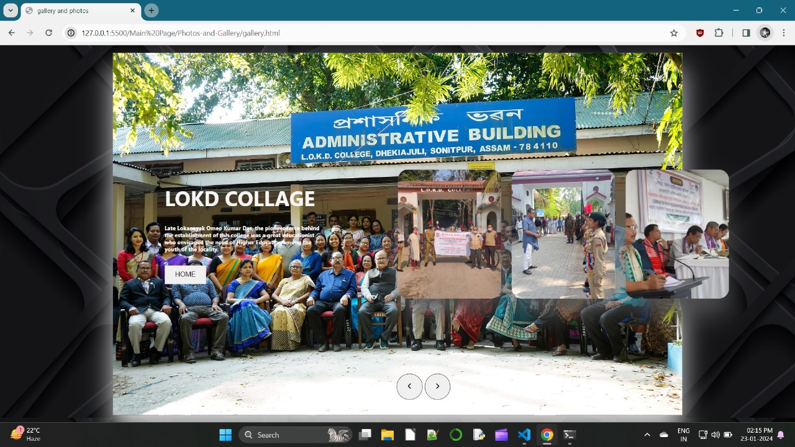
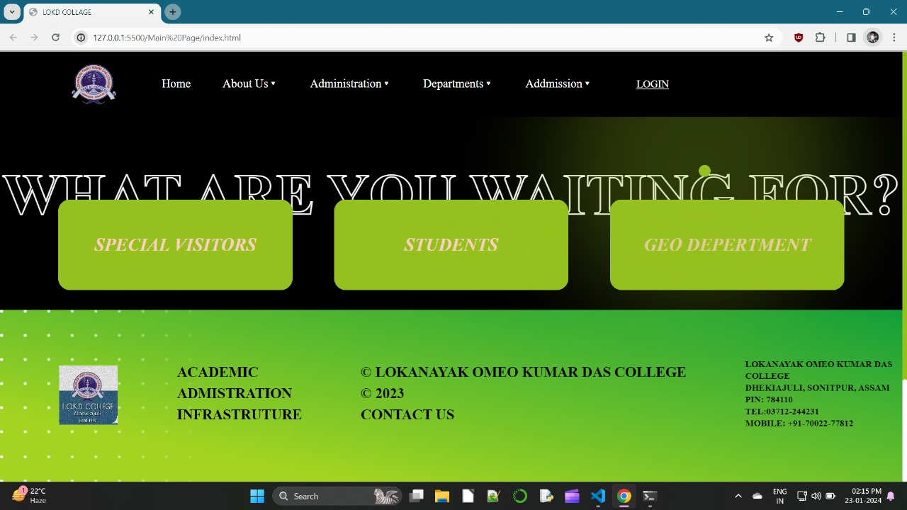
we can see the gallery tab in which one can slide through the gallery and learn about the pictures and their importance .
In this picture one can see cards made and designed with css, which changes to pictures once hovered.

Slide 10
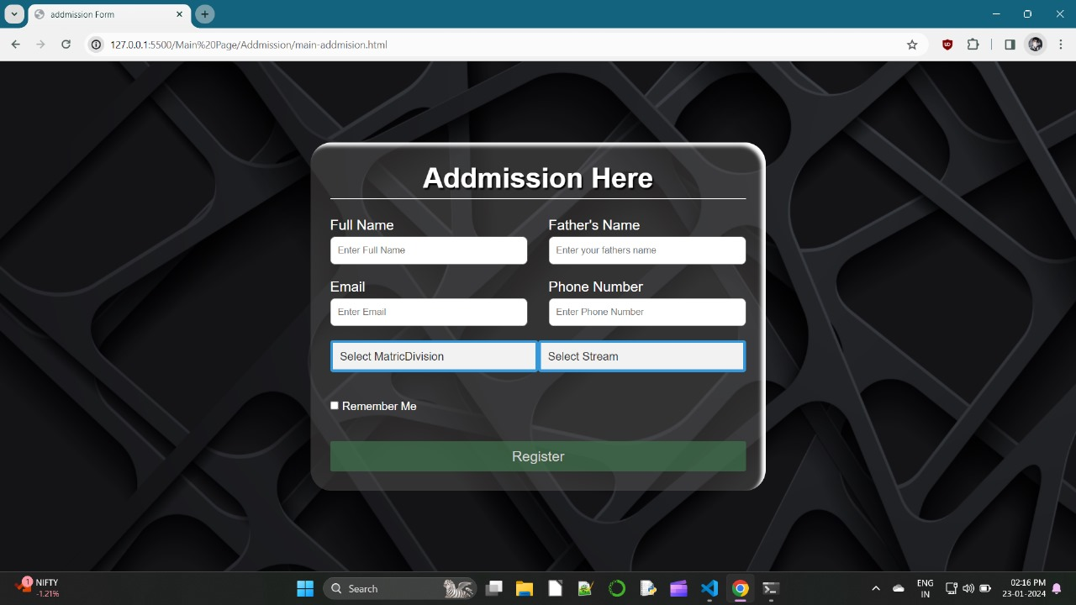
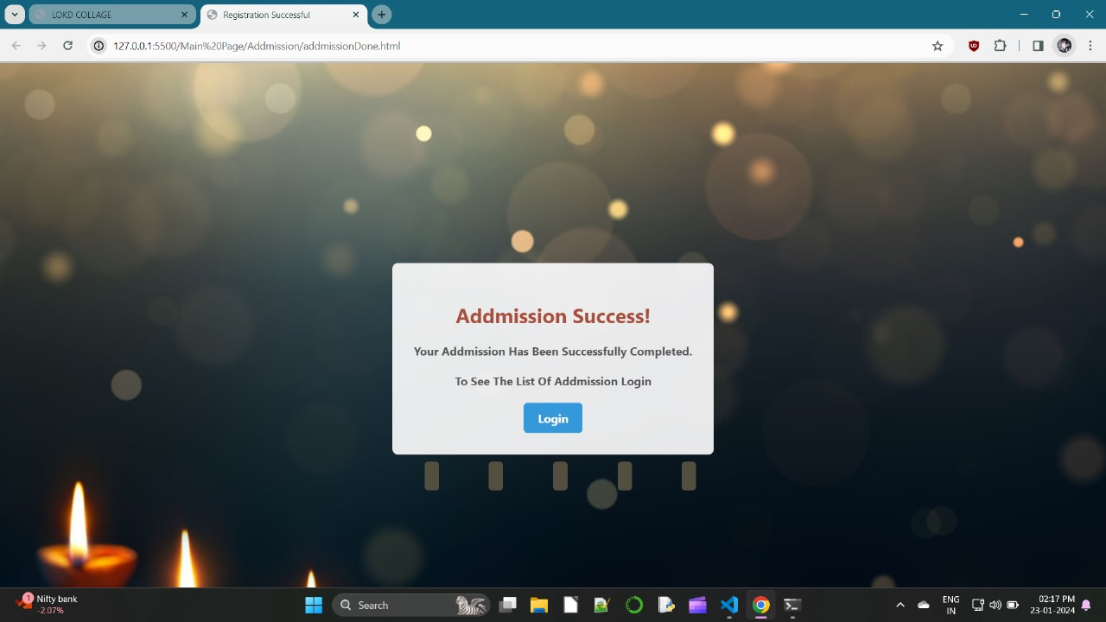
In this figure one can visit the admission tab and can apply for a admission in the college . the form is made on a card using form tags and designed with cool backgrounds and fonts using css.
In this figure one can see the successful screen, which appears when only logged in correctly.

Slide 11
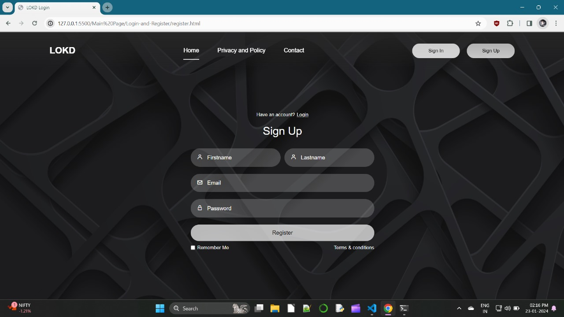
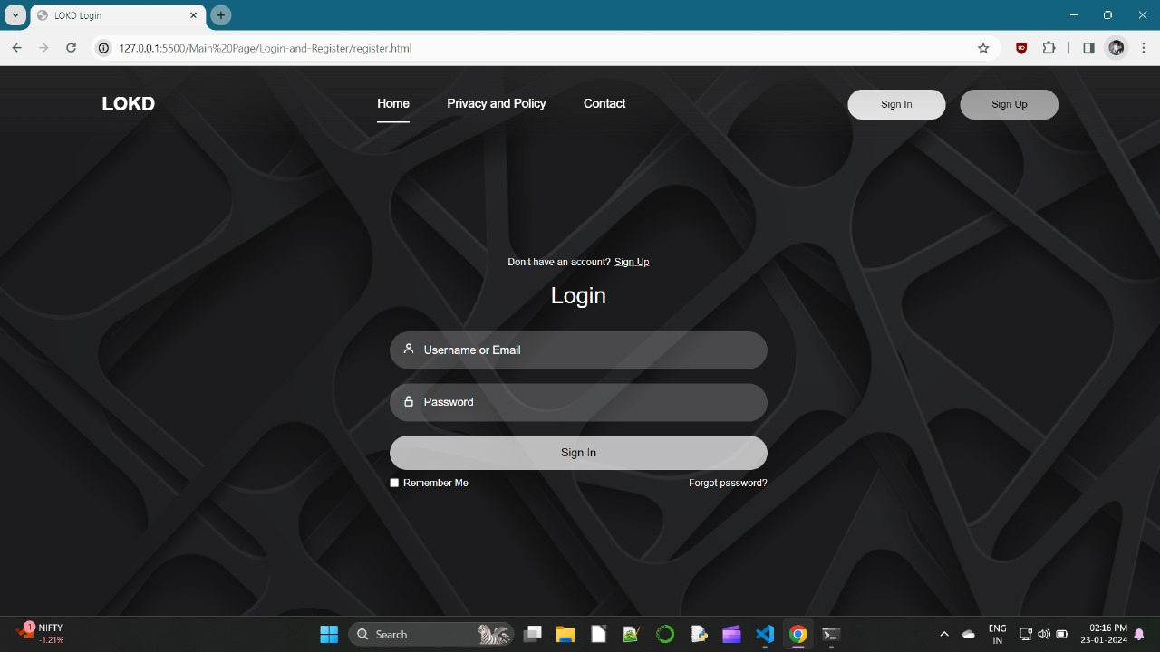
In these figures one can see login or signup pages including privacy policy which can be read before signup and contact tab.

Slide 12
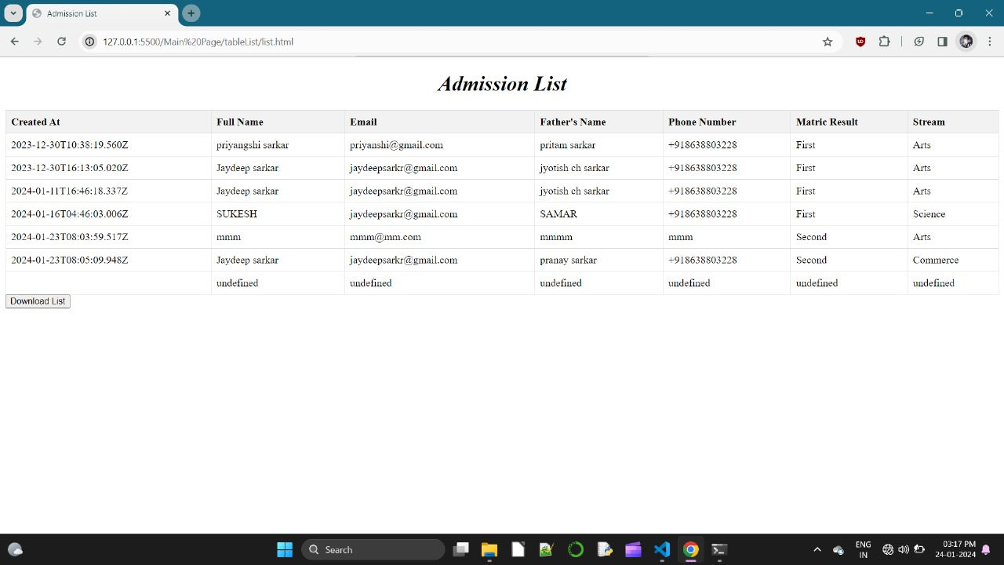
This page shows the download list after successful login

Slide 13
CONCLUSION
The project titled as “College Website” which is made keeping LOKD college in mind is a responsive website which shall help many people, students and outsiders alike and provide all the necessary information and medium to communicate with the college and provide relevant information about everything that is needed to know about the college. Our website is made and optimized to run well on mobiles and desktops alike where animations are disabled in mobiles to make the website load faster. Desktop version of the website however has small minimal animations which makes the website look better. We have tried to include as much information as possible however due to lack of some information and technical knowledge some features might be missing.
Below are some Pros and Cons of our website :
Pros :
Quick and easy navigation.
Quick means to contact via mail feature.
All information in one place.
Direct login or signup.
Cons :
Website elements align and resize differently on larger resolution screens.

Slide 14
REFERENCES
https://www.w3schools.com/html/
https://www.tutorialspoint.com/index.htm
https://www.youtube.com/
Responsive Web Design with HTML5 and CSS : Build future-proof responsive websites using the latest HTML5 and CSS techniques, Fourth Edition

Slide 15
THANK
YOU

